Slide 1
Agenda for today: Waveguides
Today we will use Lumerical MODE and FDTD to examine the properties of optical waveguides.
1) Basic waveguide theory – Slab waveguide
2) Waveguide mode simulation using Lumerical MODE
a. Calculate 1D slab waveguide modes
b. Calculate silicon photonic waveguide modes (demo)
3) Using mode port source in Lumerical FDTD (demo)

Slide 2
Optical waveguides
Slab waveguide
Ridge waveguide
Rib waveguide
$$n_{clad}$$
$$n_{clad}$$
$$n_{clad}$$
$$n_{core}$$
$$n_{core}$$
$$n_{core}$$
$$n_{clad}$$
$$n_{clad}$$
$$n_{clad}$$
An optical waveguide has the general property that there is always a material with high refractive index ($n_{core}$) surrounded by a material with lower refractive index ($n_{clad}$)
Light is confined by total internal reflection
in ray optics picture
Need wave optics to solve for guided modes
$$n_{clad}$$
$$n_{core}$$
Step-index optical fiber
Ref: Chuang, Ch. 7

Slide 3
What is a waveguide mode?
A mode (in general) is a time-harmonic solution to Maxwell’s equations (∝ e^{iωt})
A waveguide mode is a stable propagating mode with the special property that its spatial field distribution does not change with propagation (in the absence of loss)
Waveguide modes are determined by the cross-sectional refractive index profile of the waveguide
Waveguide modes are wavelength dependent
Wang et al. Opt. Express 20, 15547-15558 (2012)

Slide 4
Waveguide mode properties / figures-of-merit
Effective index: $n_{eff}$ → $k_{z}=n_{eff}\frac{2π}{λ}$
This number depends upon waveguide design and mode. Larger number means mode is more tightly confined to waveguide core.
Modal dispersion: $n_{eff}\left(ω\right)$
Modal group velocity: $v_{g}=\frac{∂ω}{∂k_{z}}$
Velocity at which energy flows
Group velocity dispersion: $D= \frac{∂(v_{g}^{−1})}{∂λ}$
Different wavelengths travel at different speeds down waveguide! Units are time per unit wavelength per unit length. Particularly important for fiber optic cable.

Slide 5
Effective index
Each mode has an effective index that can be defined by: $k_{z}=n_{eff}\frac{2π}{λ}$
The effective index tells you how tightly the mode is confined to the waveguide core
Guided mode → $n_{clad}<n_{eff}<n_{core}$
Tightly confined to the core →$n_{eff} \sim n_{core}$
Weakly confined to the core → $n_{eff} \sim n_{clad}$
Unguided or radiating modes → $n_{eff}<n_{clad}$

Slide 6
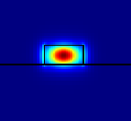
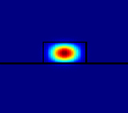
Effective index
Small effective index
Large effective index

Slide 7
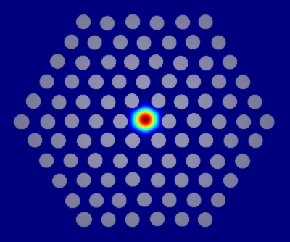
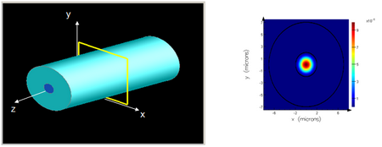
Lumerical MODE
Lumerical MODE is a finite difference frequency-domain solver that can be used to find waveguide modes
1D or 2D cross-section of a waveguide is discretized and simulated. MODE will solve for each mode and display the mode properties (e.g. $n_{eff}$, etc)
Single-mode optical fiber
Photonic crystal fiber

Slide 8
Basic waveguide theory
Time-harmonic electromagnetic fields in a source-free region must satisfy the vector Helmholtz equation
The electric-field and magnetic-field vectors in general will have components in the x, y, and z directions.
Writing out the equation for E_{x}:
$${(∇}^{2}+ω^{2}με)E=0$$
$${(∇}^{2}+ω^{2}με)H=0$$
$${(∇}^{2}+ω^{2}με)E_{x}=0$$
$$\frac{∂^{2}E_{x}}{∂x^{2}}+\frac{∂^{2}E_{x}}{∂y^{2}}+\frac{∂^{2}E_{x}}{∂z^{2}}+(ω^{2}με{)E}_{x}=0$$

Slide 9
Basic waveguide theory
Solve by separation of variables
Plug back into scalar Helmholtz equation to find:
The same can be done for the other electric and magnetic field components. Usually some field components are either exactly zero or very small and can be ignored.
$$\frac{∂^{2}E_{x}}{∂x^{2}}+\frac{∂^{2}E_{x}}{∂y^{2}}+\frac{∂^{2}E_{x}}{∂z^{2}}+(ω^{2}με{)E}_{x}=0$$
$$E_{x}=X\left(x\right)Y\left(y\right)Z(z)$$
$$X=A_{x}e^{±{jk}_{x}x}$$
$$Y=A_{y}e^{±jk_{y}y}$$
$$Z=A_{z}e^{±{jk}_{z}z}$$
$$k_{x}^{2}+k_{y}^{2}+k_{z}^{2}=k^{2}=ω^{2}με$$
Important result!

Slide 10
Solving for waveguide modes: General approach
Assume propagation in the z-direction: E, H ∝$e^{{jk}_{z}z}$
Make an educated guess for the form of the solution in each dielectric region Traveling wave: $E_{x}=E_{0}e^{jk_{x}x}e^{jk_{z}z}$ Standing wave: $E_{x}=E_{0}\cos{k_{x}x}e^{jk_{z}z}$ Decaying wave: $E_{x}=E_{0}e^{−αx}e^{jk_{z}z}$
Plug educated guess back into the Helmholtz equation and apply boundary conditions at interfaces to find characteristic equations that will allow you to solve for $k_{z}$

Slide 11
Planar slab waveguide
$$n_{clad}$$
x
z
Slab waveguide has two types of modes transverse electric (TE) and
transverse magnetic (TM)
$$n_{core}$$
d/2
y
$$n_{clad}$$
For TE mode the E-field only has a component in the y-direction. Assuming we are trying to solve for a wave guided along the z-direction we also recognize that the structure is y-invariant
therefore we can simplify the scalar Helmholtz equation as:
$$\frac{∂^{2}E_{y}}{∂x^{2}}+\frac{∂^{2}E_{y}}{∂y^{2}}+\frac{∂^{2}E_{y}}{∂z^{2}}+(ω^{2}με{)E}_{y}=0$$
$$\frac{∂^{2}E_{y}}{∂x^{2}}+\frac{∂^{2}E_{y}}{∂z^{2}}+(ω^{2}με{)E}_{y}=0$$

Slide 12
Planar slab waveguide
$$n_{clad}$$
x
z
Slab waveguide has two types of modes transverse electric (TE) and
transverse magnetic (TM)
$$n_{core}$$
d/2
y
$$n_{clad}$$
$$\frac{∂^{2}E_{y}}{∂x^{2}}+\frac{∂^{2}E_{y}}{∂z^{2}}+(ω^{2}με{)E}_{y}=0$$
The general solution will take the form:
$$E_{y}=e^{jk_{z}z}\left\{\begin{aligned}A_{y0}e^{±jk_{x1}x} \left|x\right|≥d/2 \\ A_{y1}e^{±jk_{x2}x} \left|x\right|≤d/2\end{aligned}\right.$$

Slide 13
Planar slab waveguide
$$n_{clad}$$
x
z
Slab waveguide has two types of modes transverse electric (TE) and
transverse magnetic (TM)
$$n_{core}$$
d/2
y
$$n_{clad}$$
$$\frac{∂^{2}E_{y}}{∂x^{2}}+\frac{∂^{2}E_{y}}{∂z^{2}}+(ω^{2}με{)E}_{y}=0$$
Further simplify as (even solutions):
$$E_{y}=e^{jk_{z}z}\left\{\begin{aligned}A_{y0}e^{−α(\left|x\right|−d/{2)} } \left|x\right|≥d/2 \\ A_{y1}\cos{k_{x}x }\left|x\right|≤d/2\end{aligned}\right.$$
Field decays into cladding layers
Standing wave solution in core

Slide 14
Planar slab waveguide
$$n_{clad}$$
x
z
Slab waveguide has two types of modes transverse electric (TE) and
transverse magnetic (TM)
$$n_{core}$$
d/2
y
$$n_{clad}$$
$$\frac{∂^{2}E_{y}}{∂x^{2}}+\frac{∂^{2}E_{y}}{∂z^{2}}+(ω^{2}με{)E}_{y}=0$$
Further simplify as (odd solutions):
$$E_{y}=e^{jk_{z}z}\left\{\begin{aligned}A_{y0}e^{−α(x−d/{2)} } x≥d/2 \\ A_{y1}\sin{k_{x}x }\left|x\right|≤d/2 \\ {−A}_{y0}e^{α(x+d/{2)} }x≤d/2\end{aligned}\right.$$
Field decays into cladding layers
Standing wave solution in core
Field decays into cladding layers

Slide 15
Planar slab waveguide
$$n_{clad}$$
x
z
Slab waveguide has two types of modes transverse electric (TE) and
transverse magnetic (TM)
$$n_{core}$$
d/2
y
$$n_{clad}$$
Plug back into the wave equation and apply boundary conditions to find:
Even solutions
Odd solutions
$$k_{x}^{2}+k_{z}^{2}=ω^{2}με_{1}$$
$$k_{x}^{2}+k_{z}^{2}=ω^{2}με_{1}$$
$${−α}^{2}+k_{z}^{2}=ω^{2}με_{2}$$
$$α^{2}+k_{z}^{2}=ω^{2}με_{2}$$
$$α=k_{x}\tan{(k_{x}d/2})$$
$$α=−k_{x}\cot{(k_{x}d/2})$$

Slide 16
TE modes
TE₀
TE₁
TE₂
$$n_{clad}$$
$$n_{clad}$$
$$n_{clad}$$
$$n_{core}$$
$$n_{core}$$
$$n_{core}$$
$$n_{clad}$$
$$n_{clad}$$
$$n_{clad}$$

Slide 17
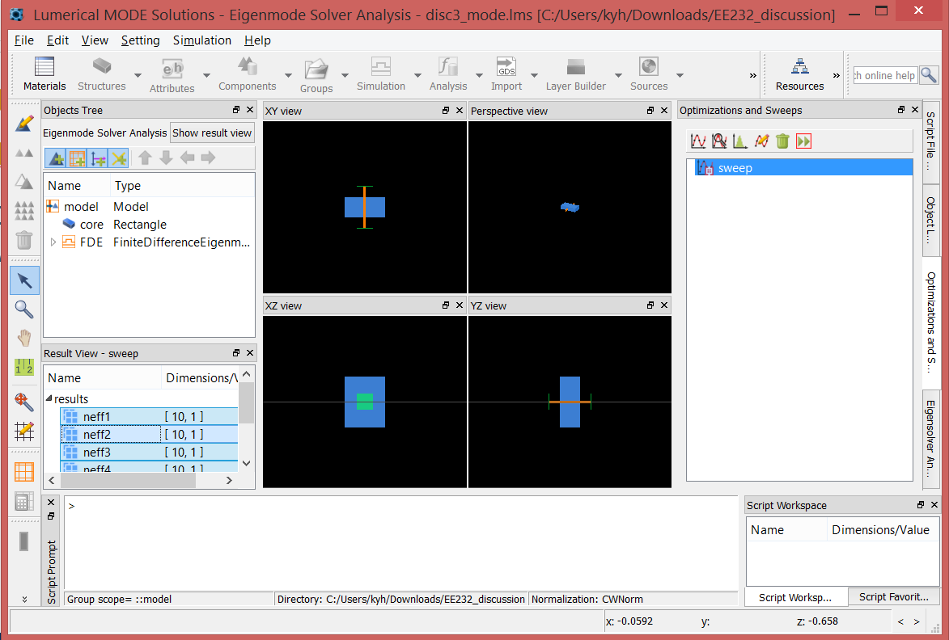
Simulating slab waveguide with Lumerical MODE
Open MODE software
Create new rectangle: Structures > Rectangle

Slide 18
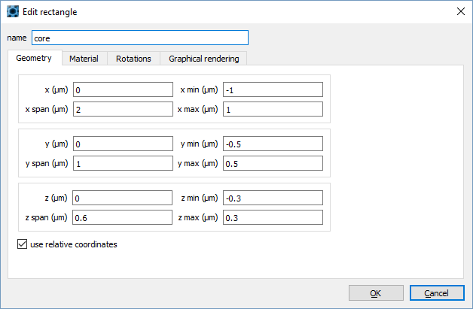
Create waveguide core

Slide 19
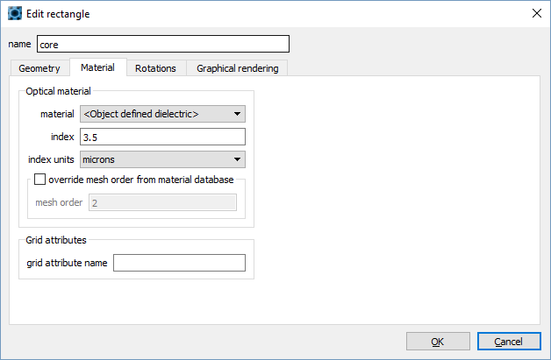
Create waveguide core

Slide 20
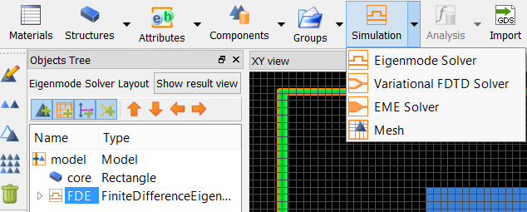
Create 1-D FDE simulation region

Slide 21
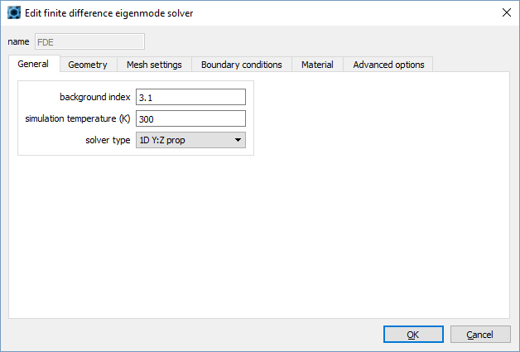
Create 1-D FDE simulation region

Slide 22
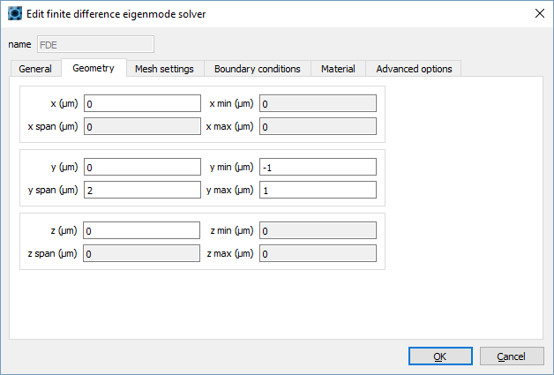
Create 1-D FDE simulation region

Slide 23
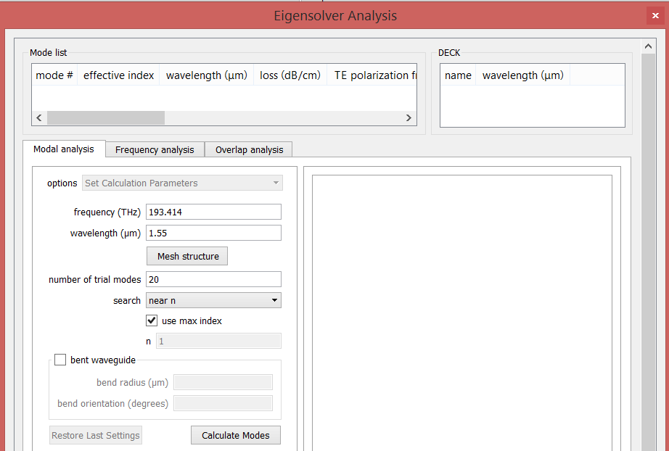
Calculate modes
Click Run
Set wavelength to 1.55 and click Calculate Modes

Slide 24
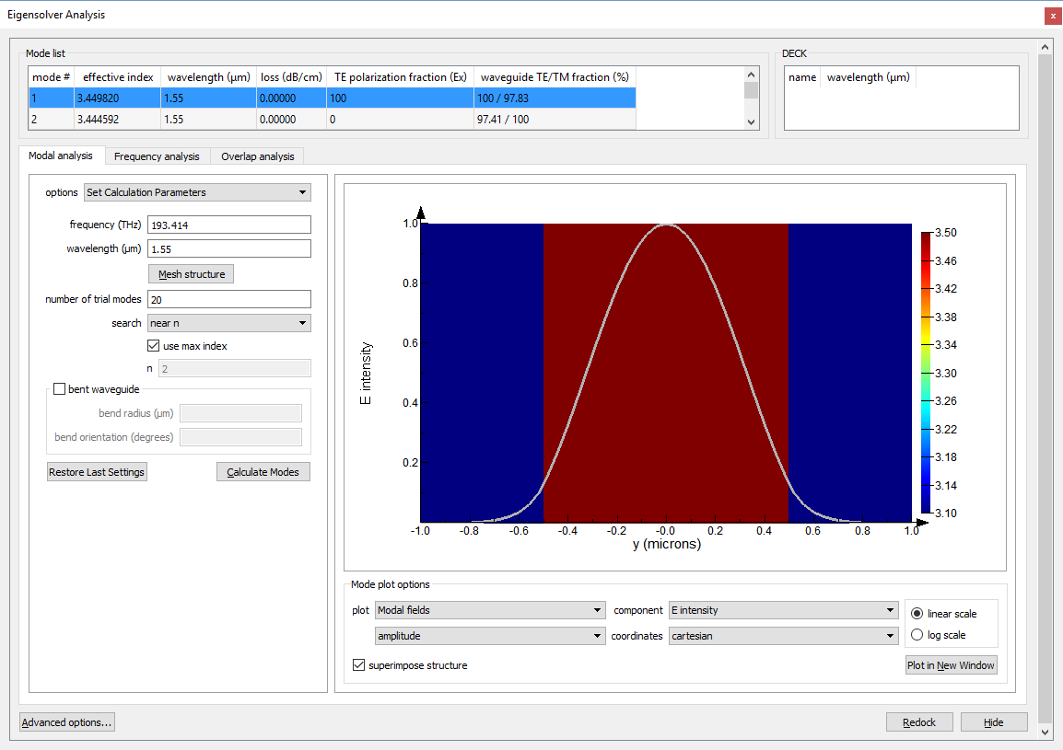
Mode list
Field profile

Slide 25
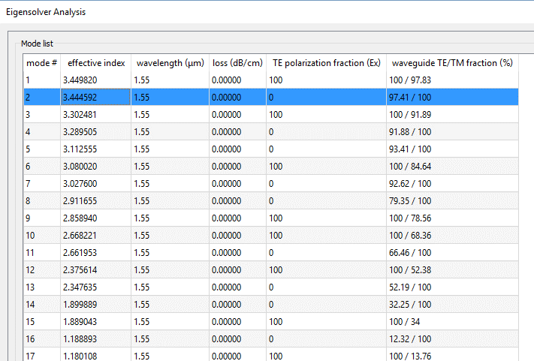
Mode analysis
There are a lot of modes here! But remember, not all of these modes are guided. Only modes with $n_{eff}>n_{clad}=3.1$ are guided modes
Guided modes
Unguided radiating modes

Slide 26
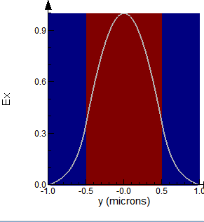
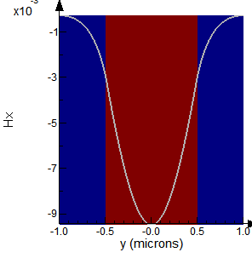
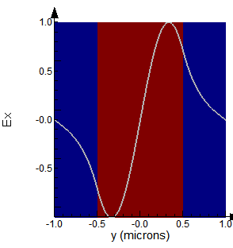
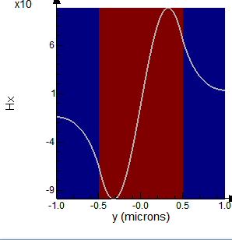
Mode analysis (guided modes)
TE₀
TM₀
TE₁
TM₁

Slide 27
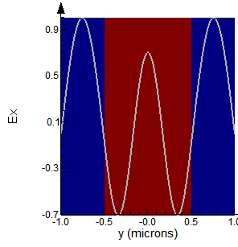
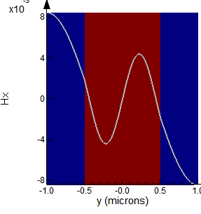
Mode analysis (unguided modes)
Notice: There is no exponential decay in the cladding! Power will be radiated
into the cladding as these unguided “modes” propagate down waveguide
Example #1
Example #2

Slide 28
Waveguide cutoff
Let’s run a parameter sweep to plot effective index as a function of slab core thickness
You should set your minimum mesh spacing to 10nm for this analysis

Slide 29
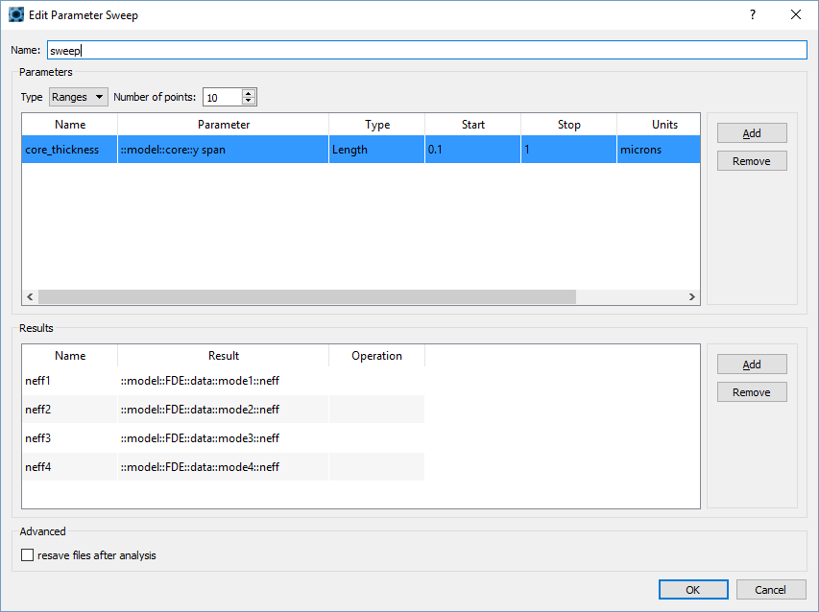
Waveguide cutoff

Slide 30
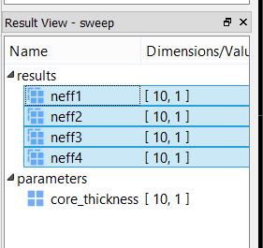
Waveguide cutoff
Click run button:
When done, select sweep, select all results in Result View (bottom left), right click > Visualize > New Visualizer

Slide 31
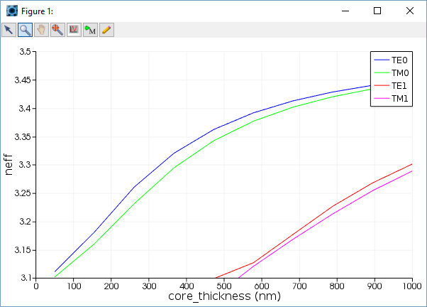
Waveguide cutoff
n_{core}
No cutoff for
TE0, TM0
TE1, TM1 cutoff
n_{cladding}
See Chuang 7.1.2

Slide 32
Rectangular waveguide
Pure TE and TM modes do not exist instead we have hybrid modes (all field components exist for each mode).
BUT, the transverse components of fields dominate and so they are often called quasi-TE and quasi-TM (often we even drop the term quasi)
$$n_{1}$$
$$n_{2}>n_{1}$$
$$n_{1}$$
x
Cross-section
z
y

Slide 33
Silicon photonic ridge waveguide
silicon
220nm
Buried oxide (BOX)
3$μ$m
Silicon substrate

Slide 34
Waveguide modes
Silicon thickness of 220nm for silicon-on-substrate (SOI) substrate is somewhat standardized
We often desire waveguide to contain only a single mode
Our goal is to determine the silicon ridge width such that that waveguide is single mode
Open Silicon_Photonic_Ridge_Waveguide.lms from the bcourses website
You will see a silicon photonic ridge waveguide with 220nm height and 900nm width.
Use MODE to calculate the guided modes.

Slide 35
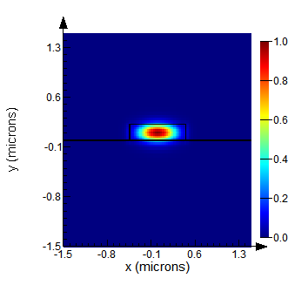
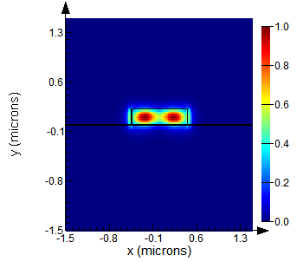
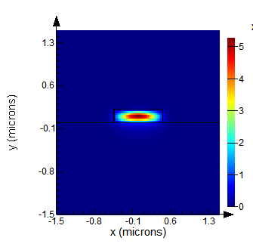
900nm width ridge waveguide
$${\left|E\right|}^{2}$$
$${\left|E\right|}^{2}$$
$${|H|}^{2}$$
Quasi-TE₀₀
Quasi-TE₁₀
Quasi-TM₀₀
E_{x} dominates,
1 lobe in x,
1 lobe in y
E_{x} dominates,
2 lobes in x,
1 lobe in y
H_{x} dominates,
1 lobe in x,
1 lobe in y

Slide 36
Single-mode waveguide
Run the parametric sweep on the silicon ridge width and plot $n_{eff}$ for each of the modes on the previous slide as a function of $n_{eff}$

Slide 37
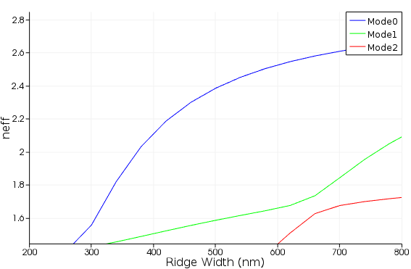
Single-mode waveguide
Single mode
Multimode
Mode crossing: Mode1 switches from TE to TM

Slide 38
Single-mode waveguide
Single mode
Multimode
Mode crossing: Mode1 switches from TE to TM
Note: Lumerical indexes modes by effective index, while we usually want to sort by spatial distribution

Slide 39
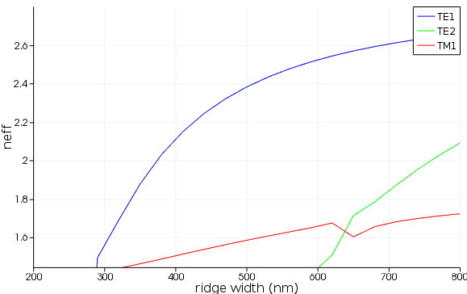
Single-mode waveguide
Index mode by eigenmode
Index mode by spatial distribution

Slide 40
Mode source in FDTD
When running FDTD simulation we often want to excite a particular waveguide mode
This can be done using a mode source in Lumerical FDTD.
Open the file Silicon_Photonic_Waveguide_Port_Source.fsp from bcourses
This Lumerical FDTD simulation file contains 3D silicon photonic ridge waveguide that we just simulated with ridge height of 220nm and ridge width of 500nm to ensure single mode operation

Slide 41
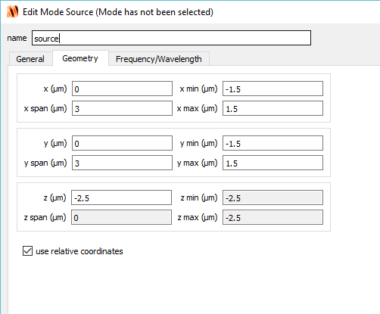
Mode source in FDTD
Click Sources → Mode
Select the geometry tab first

Slide 42
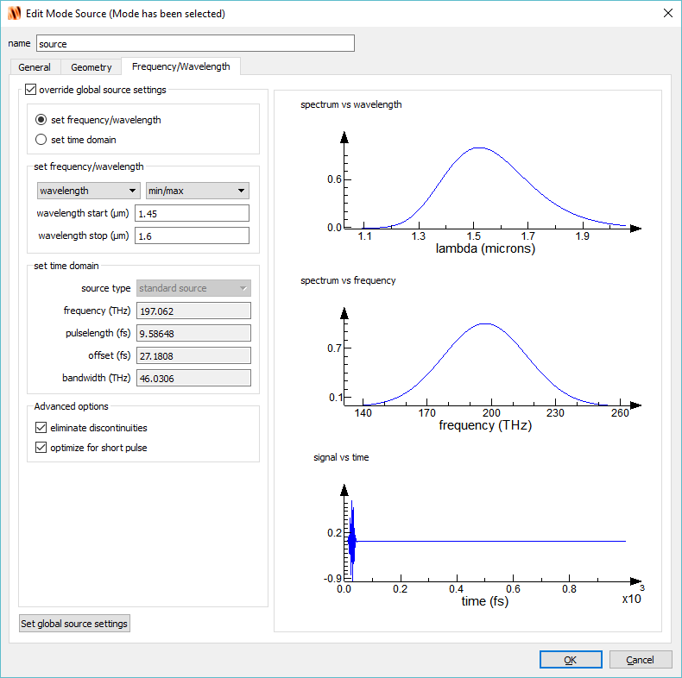
Mode source in FDTD

Slide 43
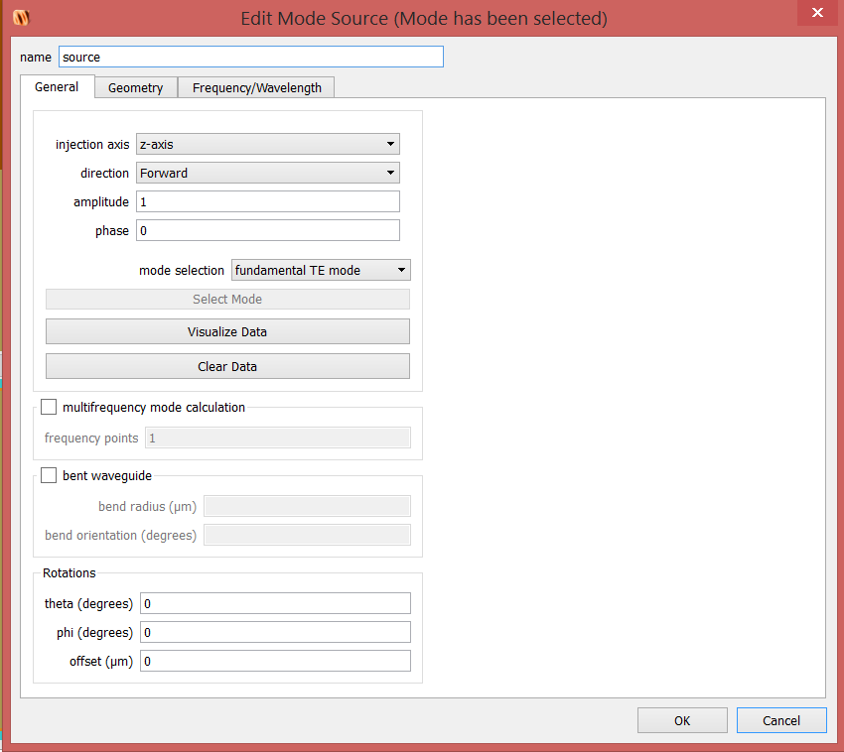
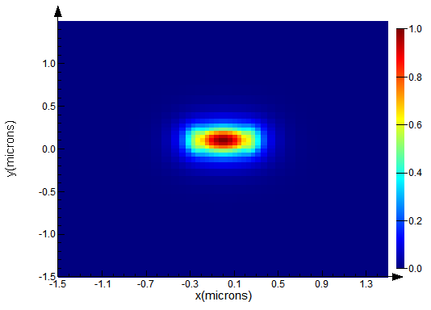
Mode source in FDTD
Click Visualize Data

Slide 44
Mode source in FDTD
A movie monitor has already been added at the x = 0 plane so that we can see the wave propagate down the waveguide
Click Run

Slide 45
Movie monitor
air
ridge
y
BOX
z

Slide 46
Limitation to port source
Caution should be used when applying port source
Port source mode is only calculated at the center frequency therefore there will be some mode mismatch (i.e. reflections) at other frequencies.
Keep this in mind if you are running a broadband simulation.

